Slide 1
Corn Acre Forecasting from Satellite Data
Sophie Roginsky
Insight AI Demo

Slide 2
Problem
Company:
Grain trading company
Problem Description:
Company interested in early crop supply estimates to determine the buying/selling value
Goal:
Can we build a model with raw satellite imagery to estimate total corn acreage in US ahead of USDA report?
https://www.nass.usda.gov/Statistics_by_State/South_Dakota/Publications/Crop_Releases/Price_Reaction/Price_Reaction19.pdf
Notes:
“Large grain traders can handle up to half a billion bushels of corn in a year”
The adjustment to the corn price due to the release of the August estimate, according to the USDA is on average +/- 7.5 cents per bushel, so if they trade half their futures before the estimate, they stand to lose (or gain) ~$18M from some foreknowledge of the planted acres.

Slide 3
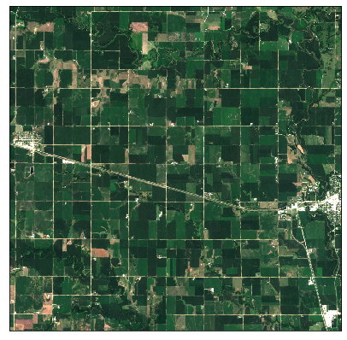
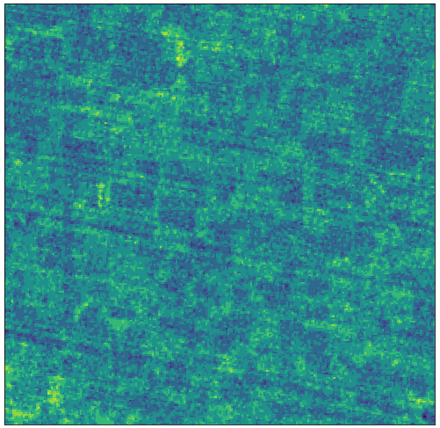
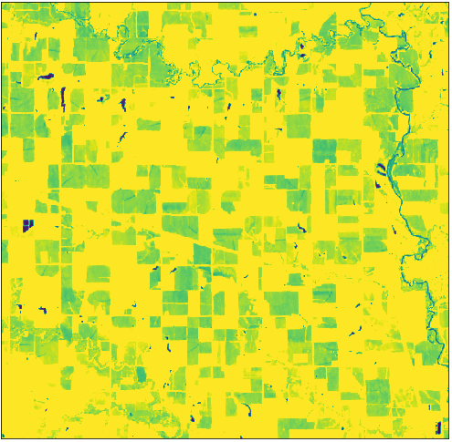
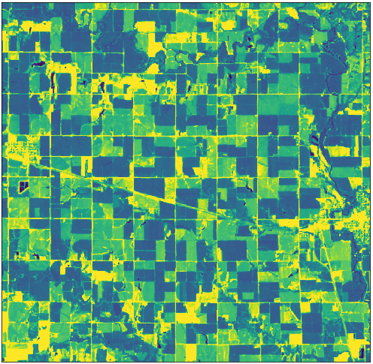
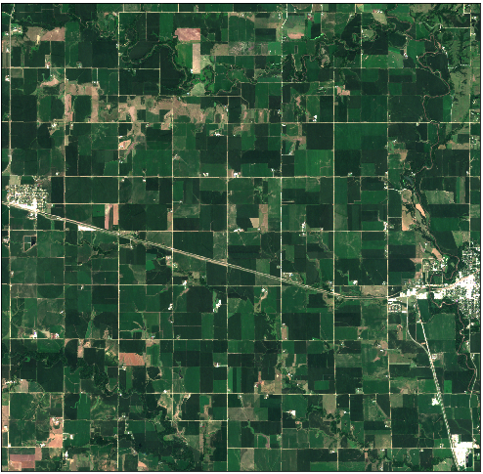
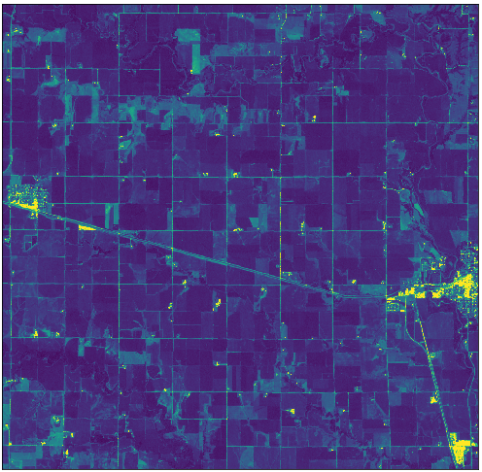
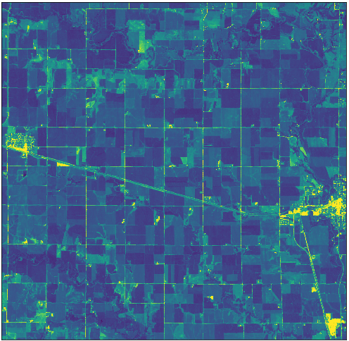
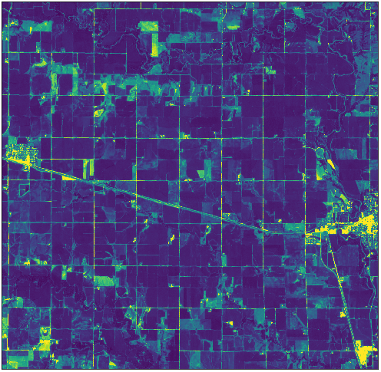
Data: Satellite Imagery
Sentinel-2 Satellite Imagery
Global coverage
Recaptured every 5 days
High-resolution, multi-spectral data
Potential Features
Spatial data
Temporal data
Spectral-band data
https://sentinel.esa.int/web/sentinel/missions/sentinel-2

Slide 4
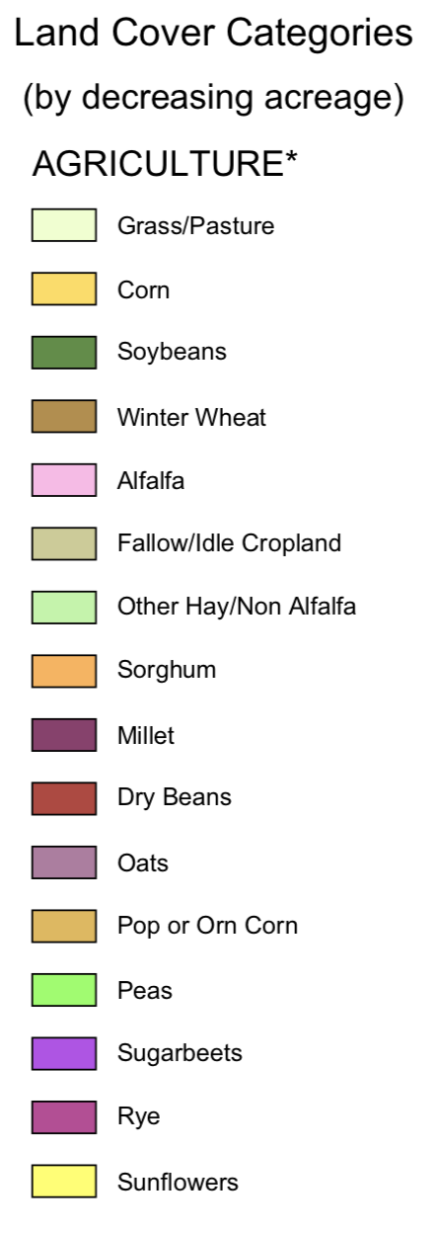
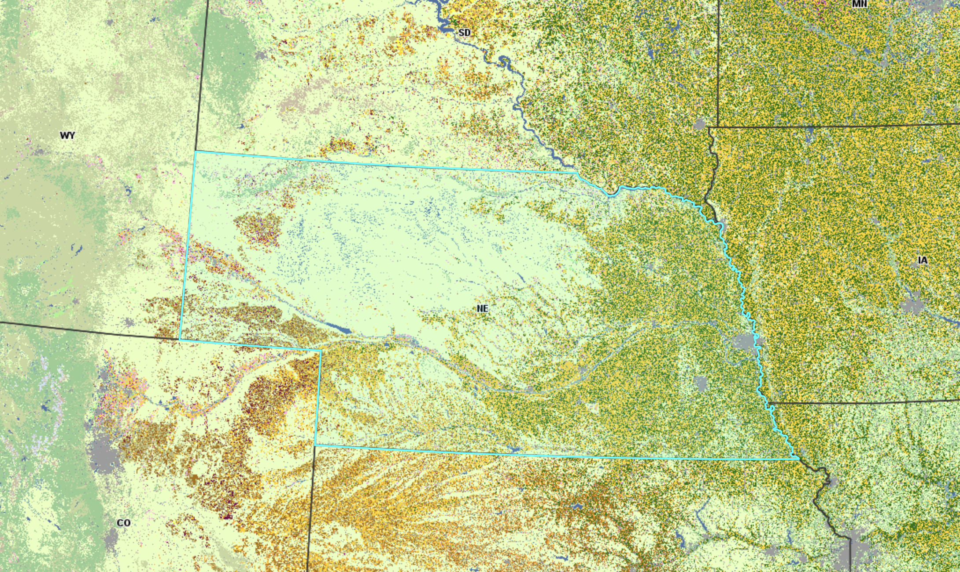
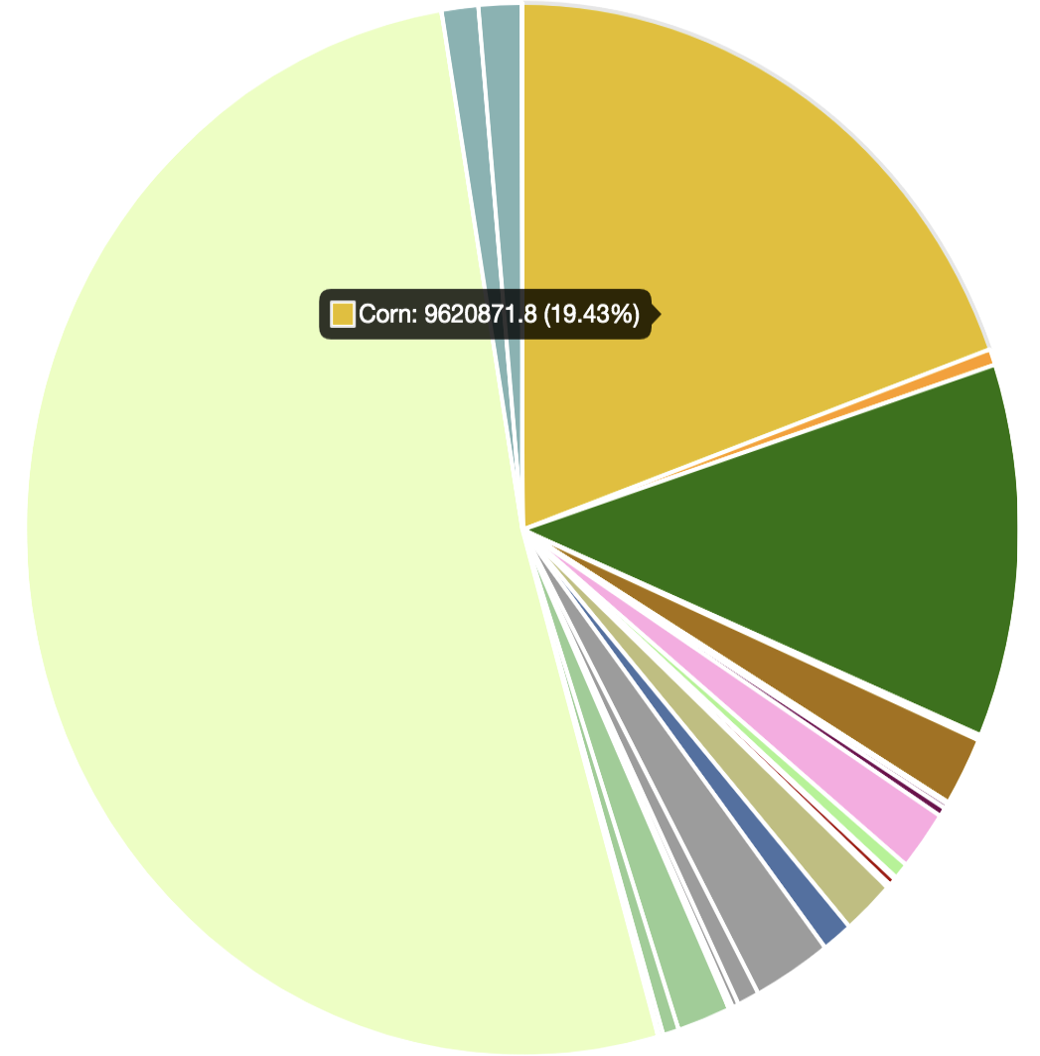
Data: Crop Labels
Source: CropScape, crop-specific land cover data layer based on USDA agricultural reports
https://nassgeodata.gmu.edu/CropScape/

Slide 5
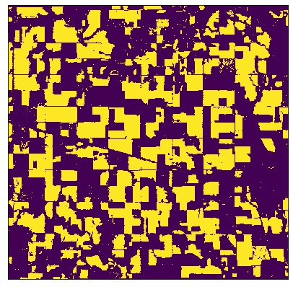
Methodology
Southeast Nebraska
Area of Interest: Southeast Nebraska
Training Dataset: July 2017
Test Dataset: July 2018
Two approaches:
Single pixel classification
Image segmentation
Input
Output
Intersection-over-Union
= TP / (TP + FP + FN)
Notes:
Data pre-processing + approaches
How/where you got the data
Train/test split

Slide 6
Approach 1: Single Pixel Classification
Method: | use spectral bands as features to classify each pixel as corn / not-corn
Model: | logistic regression for binary classification
Logistic Regression
spectral bands
B0 | B1 | B2 | … | B12
Class
0
1
1
0
pixels
Notes:
Simple, may be too simple for some problems, all about context,

Slide 7
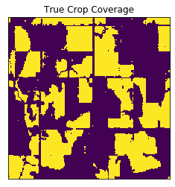
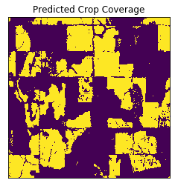
Single Pixel Classification Results
Accuracy: | 0.91
F1-Score: | 0.84
IoU: | 0.72
Predicted
 | 0 | 1
0 | 25.9 M | 2.1 M
1 | 2.1 M | 10.9 M
Actual
Precision | Out of all the pixels predicted to be corn, 84% was actually corn
Recall | Out of all actual corn pixels, 83% pixels were predicted correctly
 | precision | recall
0 | 0.93 | 0.94
1 | 0.84 | 0.83
Notes:
Precision: - What proportion of positive identifications was actually correct?
TP / (TP+FP)
Out of all the corn labeled as corn, 97% was actually corn
Recall
- Ratio of correct positive predictions to the total positives examples
TP / (TP+N)
- What proportion of actual positives was identified correctly?
25933983 2070923] [ 1817760 9377334

Slide 8

Approach 2: Image Segmentation
Method
Train on image patches
Data augmentation
Context and localization
Model: U-Net
Fully convolutional network
Symmetric contracting and expanding paths
U-Net Architecture
Ronneberger, O., Fischer, P., & Brox, T. (2015). U-net: Convolutional networks for biomedical image segmentation.
Notes:
- Pixel based in all about xontext

Slide 9
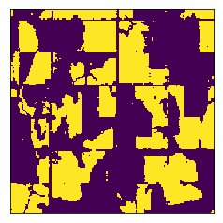
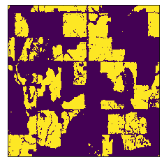
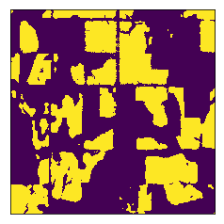
Comparing Approaches
Predicted
Ground
Truth Labels
Single Pixel
Classification
Image
Segmentation
Actual
Accuracy: | 0.91
F1-Score: | 0.84
IoU: | 0.72
Accuracy: | 0.94
F1-Score: | 0.90
IoU: | 0.82
Intersection-over-Union
= TP / (TP + FP + FN)

Slide 10
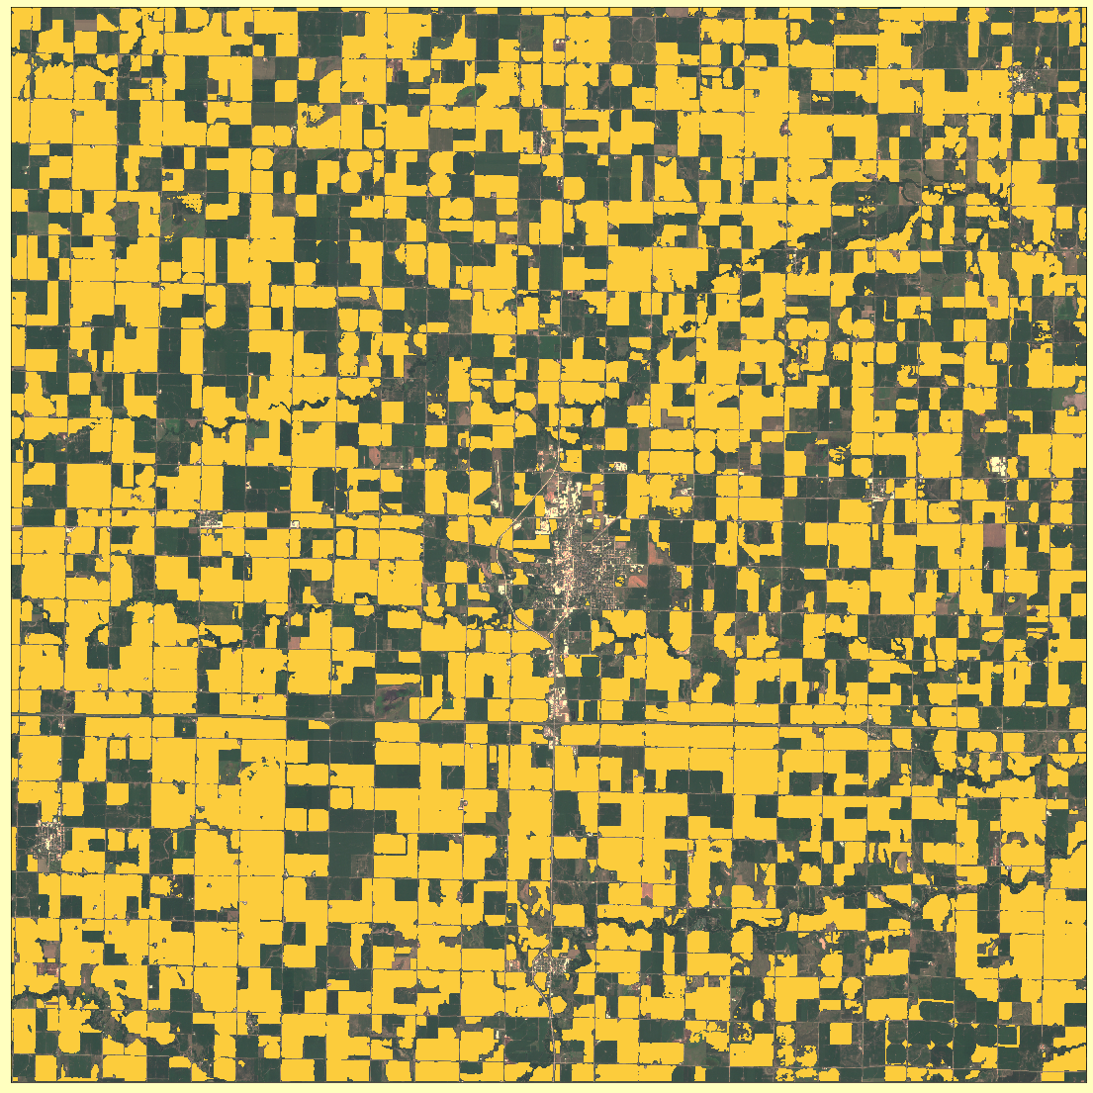
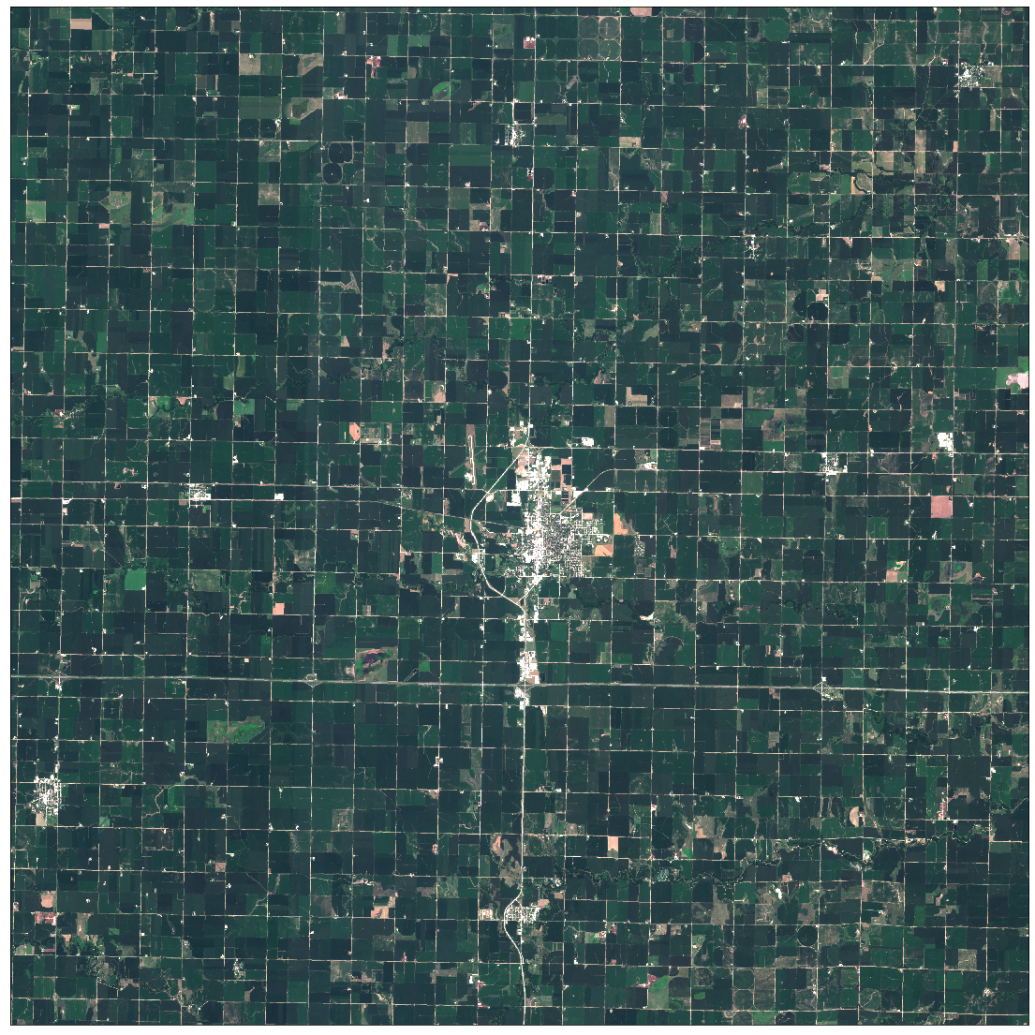
Test case: York, Nebraska, July 2018
Location: York County, Nebraska
USDA 2018 report: | 202,000 acres of corn
U-Net estimate: | 190,000 acres of corn
USDA 2018 report: | 202,000 acres of corn
Accuracy: | 0.94
F1-Score: | 0.95
IoU: | 0.90

Slide 11
AI Applications using Satellite Imagery
Retailers’ profit prediction
Detecting and counting cars in parking lots
Oil inventory estimation
Measuring oil inventory by detecting shadows
Forest fire monitoring
Detecting forest fires using visible infrared imaging
Ronneberger, O., Fischer, P., & Brox, T. (2015). U-net: Convolutional networks for biomedical image segmentation.

Slide 12
Sophie Roginsky
Data Science and Analytics MSc, Ryerson University
I like solving problems

Slide 13
Image Segmentation Results
Accuracy: | 0.94
F1-Score: | 0.90
IoU: | 0.82
Predicted
 | 0 | 1
0 | 16.0 M | 0.9 M
1 | 0.6 M | 6.6 M
Actual
Precision | Out of all the pixels predicted to be corn, 88% was actually corn
Recall | Out of all actual corn pixels, 91% pixels were predicted correctly
 | precision | recall
0 | 0.96 | 0.95
1 | 0.88 | 0.91
Notes:
Precision: - What proportion of positive identifications was actually correct?
TP / (TP+FP)
Out of all the corn labeled as corn, 97% was actually corn
Recall
- Ratio of correct positive predictions to the total positives examples
TP / (TP+N)
- What proportion of actual positives was identified correctly?
25933983 2070923] [ 1817760 9377334

